Slide 1

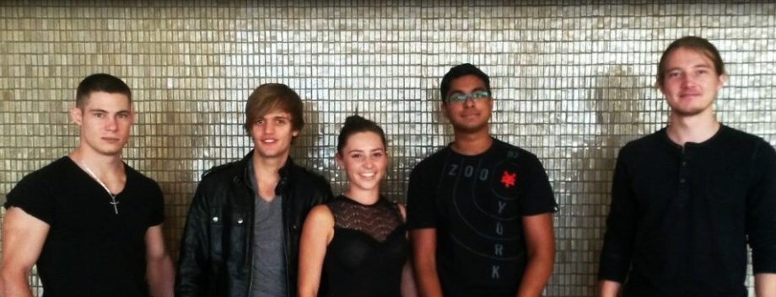
Project Linphone-Waterfall
Notes:
Deriving
ideas, style, or taste
from a broad and diverse range of sources

Slide 2

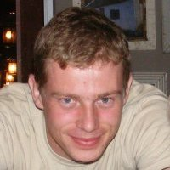
The Client
The Client 2.0
Kobus Coetzee

Slide 3
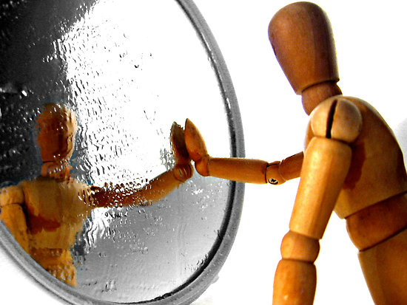
Reflection
Notes:
+ Presented with unique challenges in our project
- Large existing open source system
- Waterfall
+ Challenged Individually, and as a group
+ Assistance on offer from COS (Vreda and Stacey)
+ General Feeling from peers - Consistent work is key

Slide 4

Let’s Talk
Notes:
Jess, please share the learning curve of practically using Waterfall
Prenolan, please share your experience in the mixture of technologies and environments used for this project.
Izak, please share your experience learning and working with Android activities and fragments
Paul, please share your experience of working on a large existing project, as opposed to one from scratch.

Slide 5

Goals
Notes:
Project to be proud of
Perform for the client
Be better than other team
GEW Technologies Prize for Software Engineering Excellence!!

Slide 6
Linphone Android Group Chat
Create Group
Add Members
Remove Members
Encryption/decryption
UI Extensions

Slide 7

Thank You

